Slide 1
Track Busses
# | Booster-Bus |  | Bus Colors
 | Location | Name | North | South | Location | Hardware | Type
1 | Helix - Upper | NIL | Red | Black | Neville's Island Loop | PSXX-AR | Auto-Reverser
2 | Helix - Upper | BL | Red | Black | Branch Line | PSXX-2 | Circuit-Breaker
3 | Helix - Upper | ML | White | Blue | Main Line | PSXX-2 | Circuit-Breaker
4 | Helix - Upper | PCC | White | Blue | Pittsburgh Coke & Chemical | PSXX-1 | Circuit-Breaker
5 | Helix | HX | Red | Black | Helix | PSXX-2 | Circuit-Breaker
6 | Helix | SCY | White | Blue | Scully Yard | PSXX-2 | Circuit-Breaker
7 | Helix | ERZ | Red | Black | East Loop | PSXX-AR | Auto-Reverser
8 | West | SRZ | Red | Black | Scully Reverse Zone | AR-10 | Auto-Reverser
9 | Peninsula - Upper | BRZ | Red | Black | Branch Loop | PSXX-AR | Auto-Reverser
10 | Peninsula - Upper | CIZ | White | Blue | Canonsburg Inner | PSXX-AR | Auto-Reverser
11 | Peninsula - Upper | COZ | White | Blue | Canonsburg Outer | PSXX-AR | Auto-Reverser

Slide 2
Power Districts
PSXX-AR
CS
PSX-AR (3)
AR-10
PSXX-2
B1
PSXX-1
PSXX-2
B2
PSXX-AR
Circuit Breaker ← → Power Booster
Matrix

Slide 3
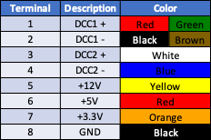
Terminal Bus Description
DCC1 – Red/Black for primary bus.
Green/Brown for secondary

Slide 4
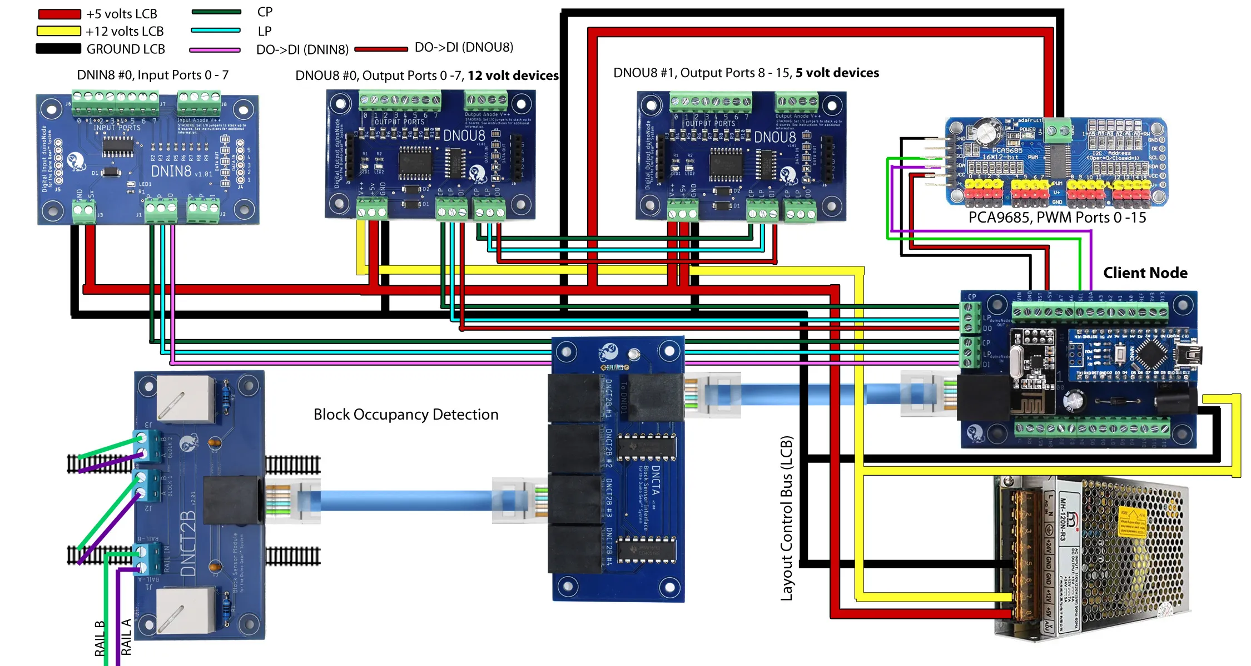
Bus Wiring
PS Output
DCC – Control Bus
DNCT2B
PSXX-2
PSXX-1
CS
B1
B2
DNCTA
DNCT2B
DNCT2B
LCN
DNCT2B
+12V LCB

Slide 5
Control Node Configuration
Block Sensors
Buttons
Turnout Sensor
DCC + Tracks
Input
Input
12v Output
5v
Output
5v
Output
To Signals
To Turnout Sensor
To Button Input
Universal Translator
MP4
To Turnout Sensor
TT

Slide 6
Turnout Wiring
The Aux relay on the MP4 switches is used to connect to the input ports on the DNIN8 as feedback for Normal and Reverse positions. The NC position should be used to drive the input indication on the universal translator.
A separate pair of inputs connect the switch contacts to an input on the DNIN8 to detect when the turnout button is pressed.
The universal translator allows the indication on the touch toggle to be represented by the position of the motor. This is necessary when also having DCC control of the turnout.
Turnout Sensor
MP4
Input
Turnout Control
12v Output
Universal Translator
Touch Toggles
Panel
TT

Slide 7
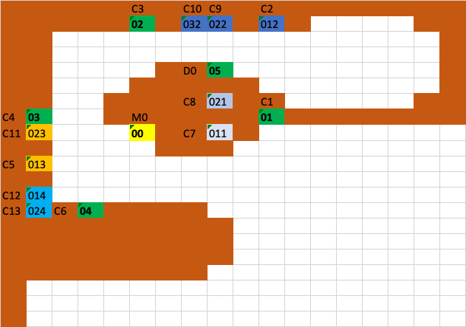
Control Node Placement

Slide 8
Protocols
Digital Command Control (DCC)
DCC sends both power and digital commands through the rails, giving each locomotive independent control. A DCC bridge passes accessory commands to LCN so turnouts and automation can be operated from both throttles and JMRI.
JMRI (Java Model Railroad Interface)
JMRI is the software hub for decoder programming, dispatching, and control panels. It controls turnouts via DCC and receives LCN state through MQTT for real-time block, turnout, and signal feedback.
LCN (Layout Control Nodes)
LCN is a wireless, distributed control system running LCOS. Nodes placed near devices handle block detection, turnouts, signals, lighting, and automation. The DCC bridge ensures accessory commands are shared between JMRI and handheld throttles.
MQTT
MQTT is the messaging layer linking JMRI and LCN. A custom LCOS node will broadcast LCN state, allowing JMRI to capture turnout commands and sensor feedback.

